Slide 1
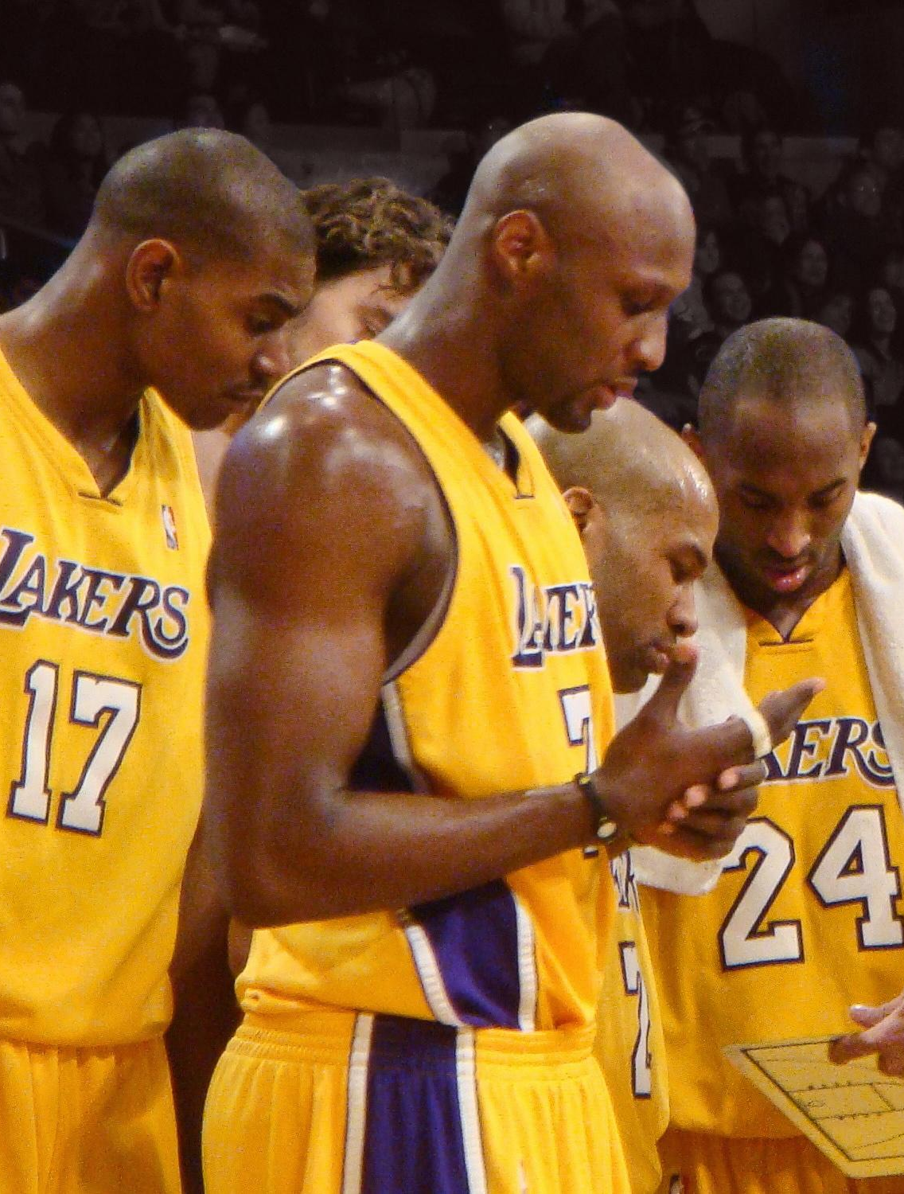
Can NBA 5-man Lineups Predict Wins?
Mihir Sabnis & Eli Tills
DSO 579
Final Project

Slide 2
Table of contents
01
02
03
04
05
06
Background & Topic
Data Collection and Preparation
Analysis
Recommendations
Model Deployment
Questions

Slide 3
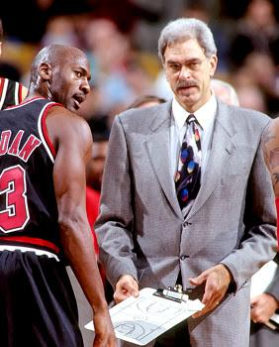
—Phil Jackson
“The strength of the team is each individual member. The strength of each member is the team.”

Slide 4
Topic
Success in basketball relies heavily on optimizing player combinations to maximize performance at critical moments. Our focus is on the Los Angeles Lakers, aiming to analyze combinations of their roster to identify which lineups made the most significant contribution to victories in the 2023. By understanding these contributions, we sought to determine the most effective lineups, strategically combining players whose strengths and statistics complement each other to enhance overall team success.

Slide 5
Abstract
How do various player combinations in the 5-man lineup contribute to game outcomes (win/loss) for the Los Angeles Lakers?
Utilizing supervised machine learning models like Test Logistic Regression, Decision Trees, Random Forest, and XGBoost we can determine the 5-man combinations that are most effective for predicting a win.
Goal: To determine the optimal lineup configurations that maximize team success, providing actionable insights for coaches and analysts.
Notes:
This project investigates how various player combinations (lineups) contribute to game outcomes (win/loss) for the Los Angeles Lakers. Using advanced ensemble methods like Random Forest, the analysis evaluates key lineup performance metrics such as plus/minus ratings, offensive/defensive ratings, and efficiency scores. The goal is to determine the optimal lineup configurations that maximize team success, providing actionable insights for coaches and analysts.

Slide 6
Hypothesis
Offensive combinations provide the best offensive stats, while defensive combinations provide the best defensive stats, and playmaking combinations provide the best playmaking stats.
H0: There is no relation between the player combinations and win/loss

Slide 7
Solutions Approach
Data Collection
(NBA Application Program Interface)
Data Preparation
(Remove Duplicates, normalize variables, dummy variables, encode categorical data)
Model Building
( Logistic Regression, Decision Trees, Random Forest, XGBoost,)
Mode Evaluation
(Metrics: Precision, Recall, F1-Score, AUC-ROC,,)
Best Model Selection
(Metrics: F1-Score, AUC-ROC, Log Loss,)
Deployment & Insights
(Recommendations for Coaches and Analysts)

Slide 8
Data Collection and Preparation

Slide 9
Building NBA API and Web Scraper
Began looking for NBA datasets to collect through the NBA and ESPN websites. We chose the NBA Advanced Stats
Through our research, we learned we could create an application programming interface that provides access to a wide range of data.
We learned that there was an open source Python Library designed to interact with the NBA stats API.
We also directly requested the ‘Lineups’ endpoint
Eventually scrapped the data from the website due to the endpoint rate-limiting us

Slide 10
II. Collection, Cleaning, and Organization
The data we wanted to collect to build our model off of focused on the 2023-2024 Season of the Los Angeles Lakers.
The data came with many excess data columns which we had to drop since they were aggregates of other columns and would lead to collinearity
Utilization of dummy combinations.
Separate the data column into 3 categories -

Slide 11
Data Categories
Offensive Stats
Defensive Stats
Playmaking Stats
OFFRTG
OREB%
EFG%
TS%
PACE
PIE
MIN
DEFRTG
DREB%
REB%
NETRTG%
MIN
AST%
AST/TO
AST RATIO
TO RATIO
MIN

Slide 12
Data Features
LINEUPS: The combination of players on the court during the game.
MIN: Total minutes played by the lineup in the game.
OFFRTG: Offensive rating – Points scored per 100 possessions by the lineup.
DEFRTG: Defensive rating – Points allowed per 100 possessions by the lineup.
NETRTG: Net rating – The difference between offensive and defensive ratings.
AST%: Assist percentage – The percentage of field goals assisted while the lineup is on the court.
AST/TO: Assist-to-turnover ratio – Ratio of assists to turnovers for the lineup.
AST RATIO: Assist ratio – Assists per 100 possessions for the lineup.
OREB%: Offensive rebound percentage – Percentage of available offensive rebounds secured by the lineup.
DREB%: Defensive rebound percentage – Percentage of available defensive rebounds secured by the lineup.
REB%: Total rebound percentage – Percentage of all available rebounds secured by the lineup.
TO RATIO: Turnover ratio – Turnovers per 100 possessions for the lineup.
EFG%: Effective field goal percentage – Adjusts field goal percentage for the value of 3-point shots.
TS%: True shooting percentage – Accounts for field goals, 3-pointers, and free throws.
PACE: Pace – The number of possessions played per 48 minutes.
PIE: Player Impact Estimate – Measures the impact of the lineup on the game.
WIN: Whether the team won that game

Slide 13
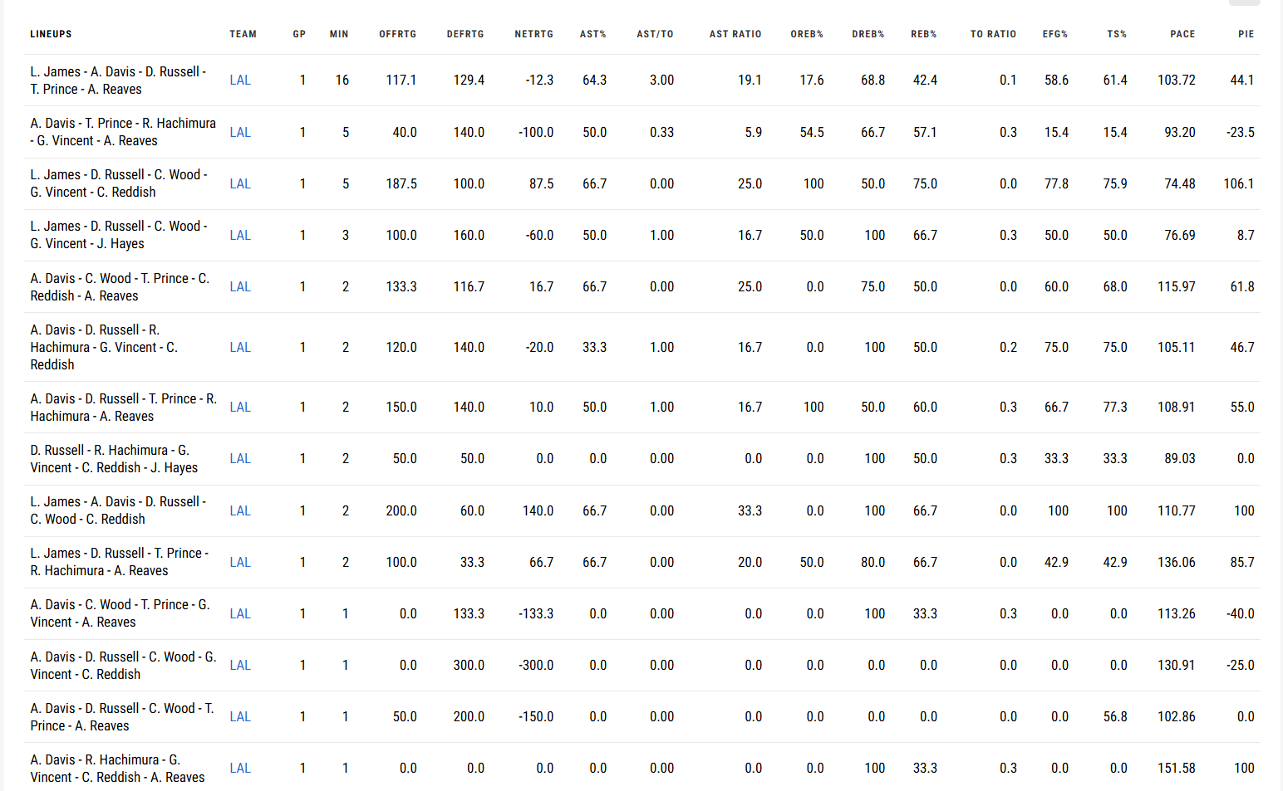
Raw Data

Slide 14
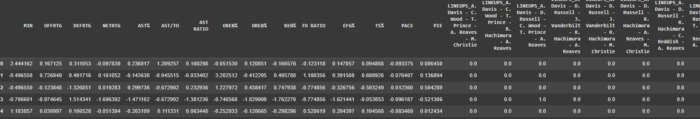
Normalized and Transformed
20,349 Possible Combinations (21 players)
414 Unique Combinations
64 5-man combinations played more than 4 times

Slide 15
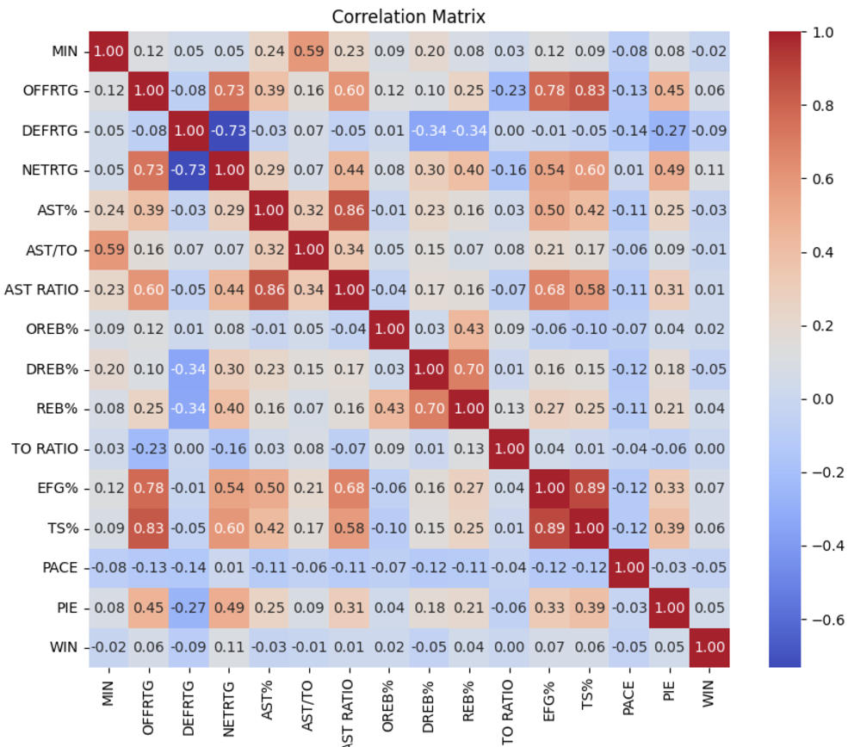
Correlation Matrix
All predictors have a very low correlation with wins. We want to investigate whether the patterns change stratified by the 5-man combination

Slide 16
Models Evaluated
Logistic Regression
Decision Trees with Gridsearch and Cross Validation
Random Forest with Gridsearch and Cross Validation
XGBoost with Gridsearch and Cross Validation

Slide 17
Model Criterion Results (No Player Combinations)
Model | Precision | Recall | F1-Score | AUC-ROC
Logistic Regression | 0.62 | 0.76 | 0.68 | 0.52
Decision Trees | 0.61 | 0.83 | 0.71 | 0.58
Random Forest | 0.57 | 0.8 | 0.67 | 0.55
XGBoost | 0.61 | 1.00 | 0.76 | 0.5

Slide 18
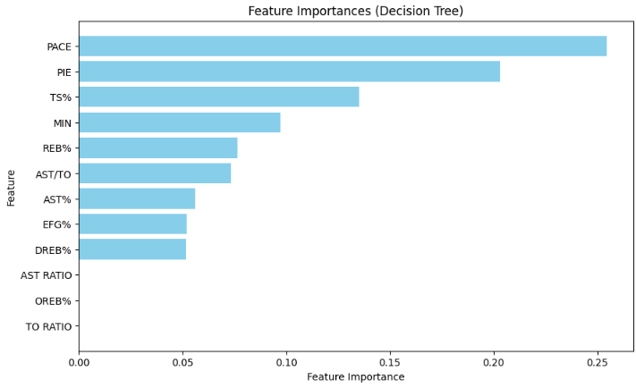
Model Criterion Feature Importance
(No Player Combinations)

Slide 19
Model Criterion Results
Model | Precision | Recall | F1-Score | AUC-ROC
Logistic Regression | 0.62 | 0.76 | 0.68 | 0.52
Decision Trees | 0.59 | 0.62 | 0.60 | 0.46
Random Forest | 0.62 | 0.59 | 0.6 | 0.5
XGBoost | 0.61 | 0.83 | 0.70 | 0.48

Slide 20
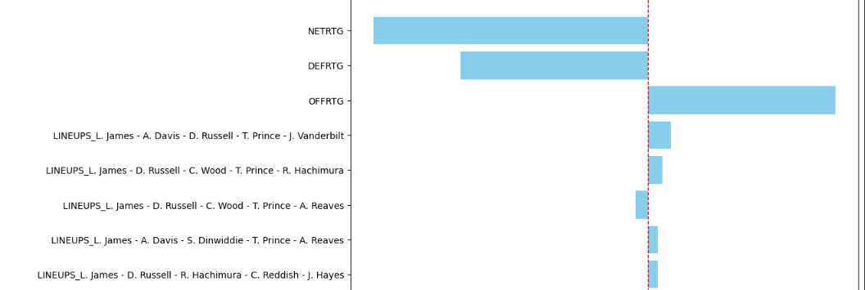
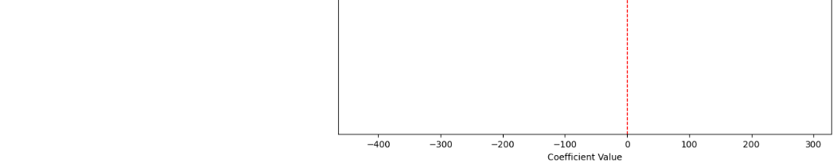
Model Criterion Feature Importance

Slide 21
Model Criterion Results (Offensive)
Model | Precision | Recall | F1-Score | AUC-ROC
Logistic Regression | 0.61 | 0.72 | 0.66 | 0.47
Decision Trees | 0.61 | 0.93 | 0.73 | 0.50
Random Forest | 0.60 | 0.79 | 0.68 | 0.49
XGBoost | 0.61 | 1.00 | 0.76 | 0.52

Slide 22
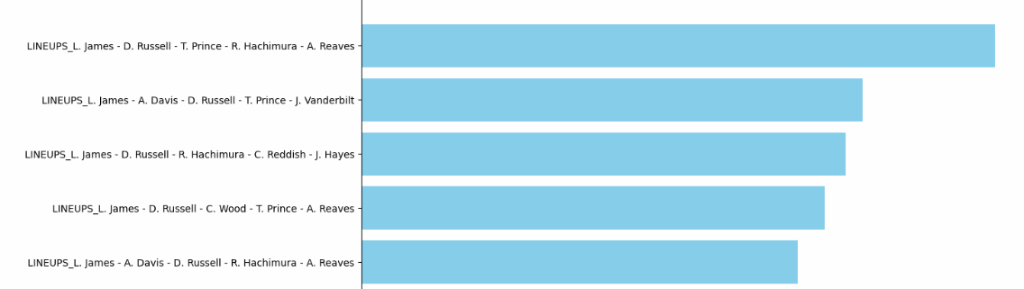
Model Criterion Feature Importance (Offensive)

Slide 23
Model Criterion Results (Defensive)
Model | Precision | Recall | F1-Score | AUC-ROC
Logistic Regression | 0.63 | 0.70 | 0.67 | 0.50
Decision Trees | 0.60 | 0.68 | 0.64 | 0.48
Random Forest | 0.62 | 0.89 | 0.73 | 0.50
XGBoost | 0.59 | 0.90 | 0.72 | 0.46

Slide 24
Model Criterion Results (Playmaking)
Model | Precision | Recall | F1-Score | AUC-ROC
Logistic Regression | 0.62 | 0.70 | 0.66 | 0.49
Decision Trees | 0.69 | 0.58 | 0.63 | 0.60
Random Forest | 0.60 | 0.72 | 0.65 | 0.44
XGBoost | 0.61 | 0.93 | 0.73 | 0.46

Slide 25
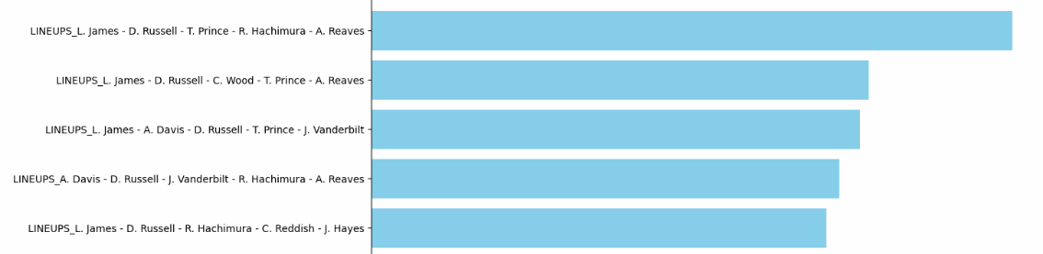
Model Criterion Feature Importance (Playmaking)

Slide 26
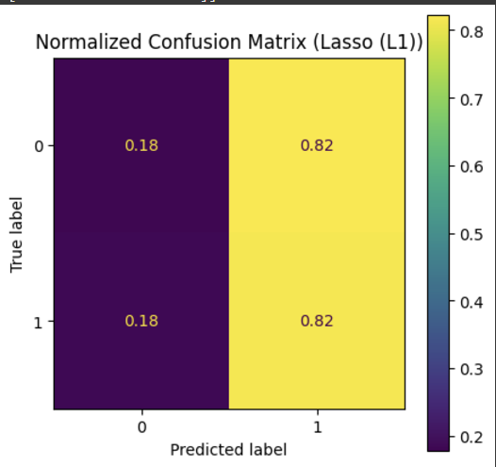
Model Implications
While there were a few features that were minorly significant, if we tried to remove the other features from the model they would end up being insignificant
None of our models were able to score significantly higher than a random guess
None of them were able to do better than a random guess for defensive stats
Alternate feature engineering methods may help
We can conclude that none of the features can significantly conclude a win or a loss
Lakers inconsistent performance - 414 combinations played

Slide 27
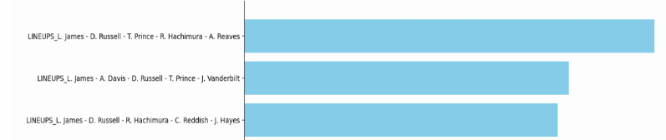
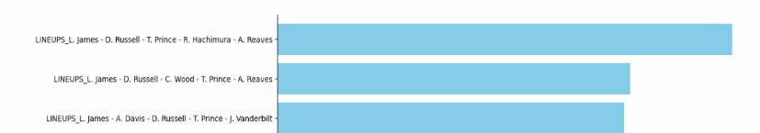
Most Contributing 5-Man Combinations
For Offensive Stats
For Playmaking Stats

Slide 28
Recommendations

Slide 29
Future Considerations
Finding more significant predictors. This would require a lot more time to collect aggregate the data
Include the opposing teams data against our teams data, so we can evaluate overall game performance and have a better prediction of the outcomes
Run this for other teams, to see a standalone of their players performance
Run a 2-man, 3-man combos
Are 5-man combination as important 2-man and 3-man over time

Slide 30




Model Deployment
Model will look at historic performance of 5-man combinations to recommend the next games 5-man teams:
Integration into Game Strategy
Preparation for upcoming opponents
Determining the next substitution

Slide 31
—Phil Jackson
“The strength of the team is each individual member. The strength of each member is the team.”

Slide 32
Questions?

Slide 33
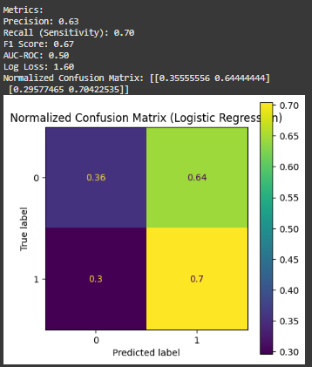
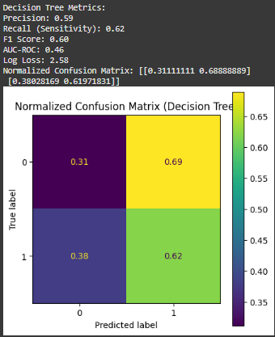
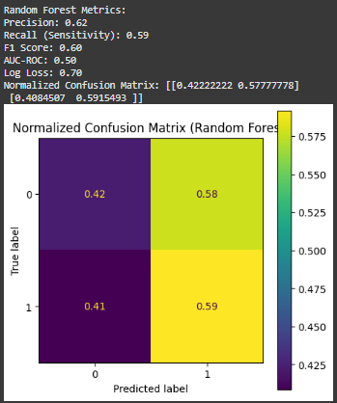
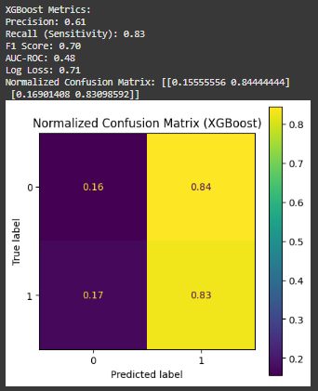
5-man All Stats
Model | Precision | Recall | F1-Score | AUC-ROC
Logistic Regression | 0.62 | 0.76 | 0.68 | 0.52
Decision Trees | 0.59 | 0.62 | 0.60 | 0.46
Random Forest | 0.62 | 0.59 | 0.6 | 0.5
XGBoost | 0.61 | 0.83 | 0.70 | 0.48

Slide 34
5-man All Stats
Model | Precision | Recall | F1-Score | AUC-ROC
Logistic Regression | 0.62 | 0.76 | 0.68 | 0.52
Decision Trees | 0.59 | 0.62 | 0.60 | 0.46
Random Forest | 0.62 | 0.59 | 0.6 | 0.5
XGBoost | 0.61 | 0.83 | 0.70 | 0.48

Slide 35
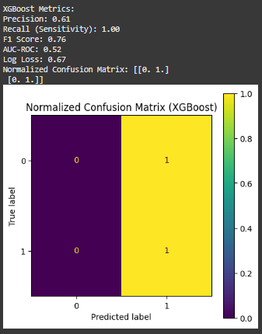
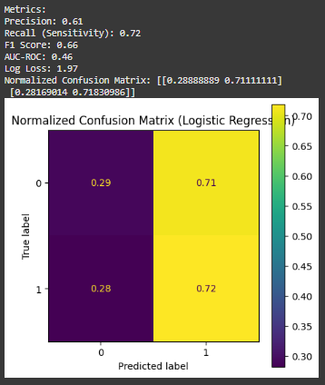
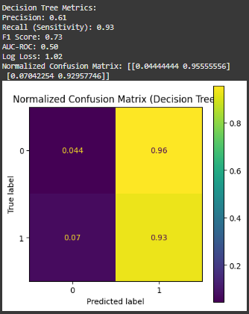
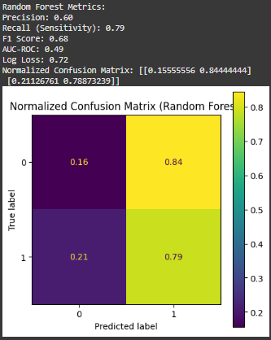
5-man Offensive Stats
Model | Precision | Recall | F1-Score | AUC-ROC
Logistic Regression | 0.61 | 0.72 | 0.66 | 0.47
Decision Trees | 0.61 | 0.93 | 0.73 | 0.50
Random Forest | 0.60 | 0.79 | 0.68 | 0.49
XGBoost | 0.61 | 1.00 | 0.76 | 0.52

Slide 36
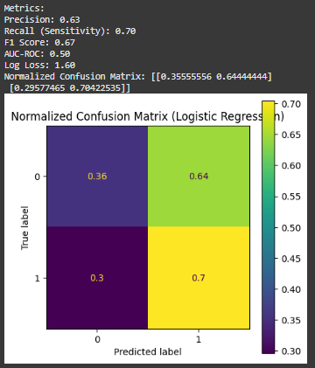
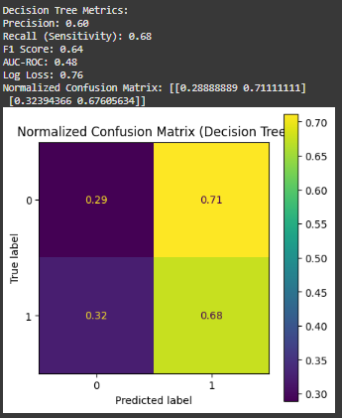
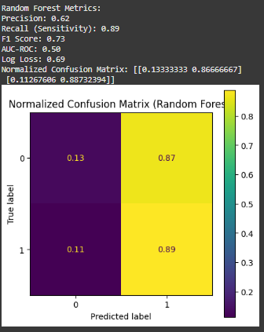
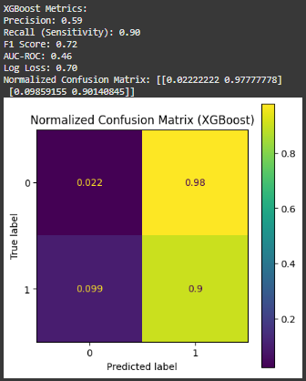
5-man Defensive Stats
Model | Precision | Recall | F1-Score | AUC-ROC
Logistic Regression | 0.63 | 0.70 | 0.67 | 0.50
Decision Trees | 0.60 | 0.68 | 0.64 | 0.48
Random Forest | 0.62 | 0.89 | 0.73 | 0.50
XGBoost | 0.59 | 0.90 | 0.72 | 0.46

Slide 37
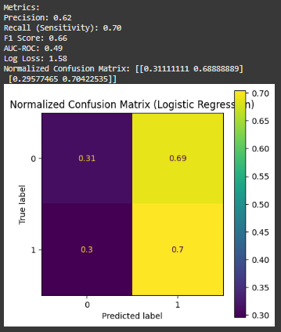
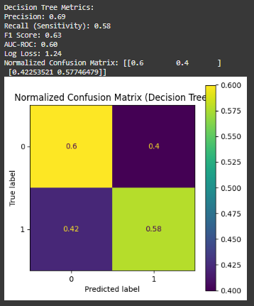
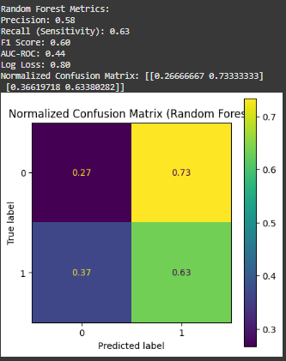
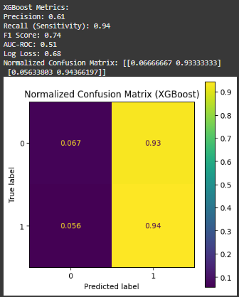
5-man Playmaking Stats
Model | Precision | Recall | F1-Score | AUC-ROC
Logistic Regression | 0.62 | 0.70 | 0.66 | 0.49
Decision Trees | 0.69 | 0.58 | 0.63 | 0.60
Random Forest | 0.58 | 0.63 | 0.60 | 0.44
XGBoost | 0.61 | 0.94 | 0.74 | 0.51

Slide 38
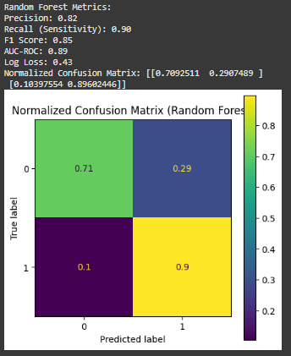
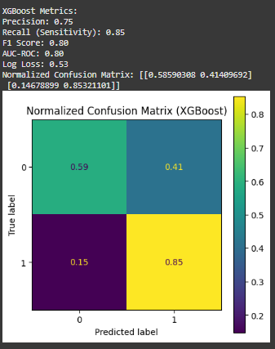
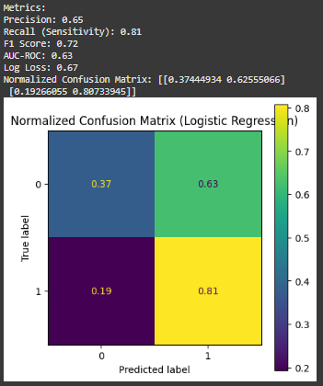
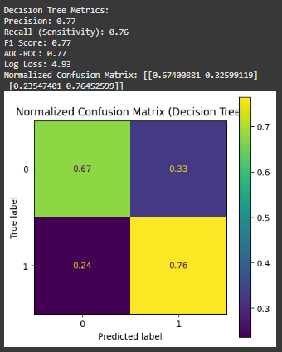
3-man All Stats
Model | Precision | Recall | F1-Score | AUC-ROC
Logistic Regression | 0.65 | 0.81 | 0.72 | 0.63
Decision Trees | 0.77 | 0.76 | 0.77 | 0.77
Random Forest | 0.82 | 0.90 | 0.85 | 0.89
XGBoost | 0.75 | 0.85 | 0.80 | 0.80

Slide 39
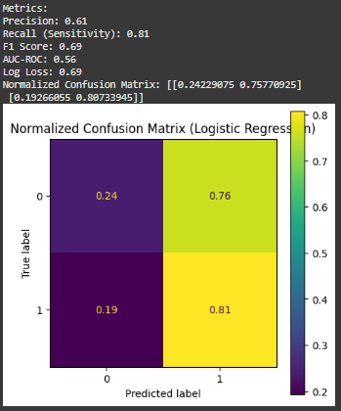

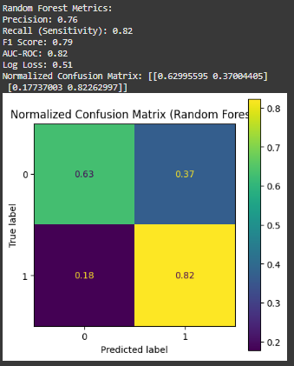
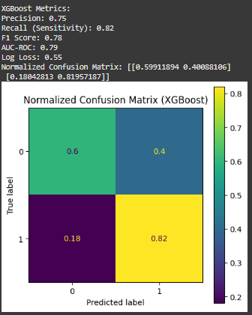
3-man Offensive Stats
Model | Precision | Recall | F1-Score | AUC-ROC
Logistic Regression | 0.61 | 0.81 | 0.69 | 0.56
Decision Trees | 0.75 | 0.74 | 0.75 | 0.73
Random Forest | 0.76 | 0.82 | 0.79 | 0.82
XGBoost | 0.75 | 0.82 | 0.78 | 0.79

Slide 40
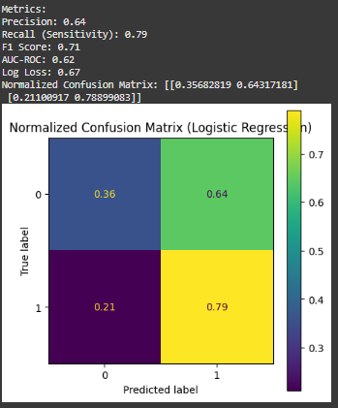
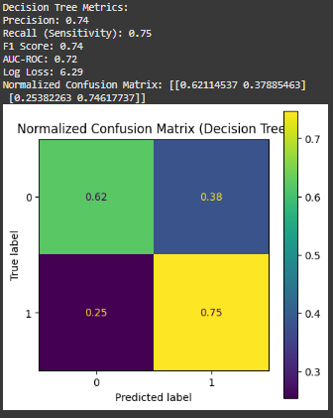

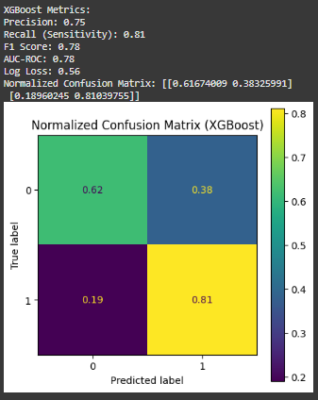
3-man Defensive Stats
Model | Precision | Recall | F1-Score | AUC-ROC
Logistic Regression | 0.64 | 0.79 | 0.71 | 0.62
Decision Trees | 0.74 | 0.75 | 0.74 | 0.72
Random Forest | 0.75 | 0.81 | 0.78 | 0.79
XGBoost | 0.75 | 0.81 | 0.78 | 0.78

Slide 41
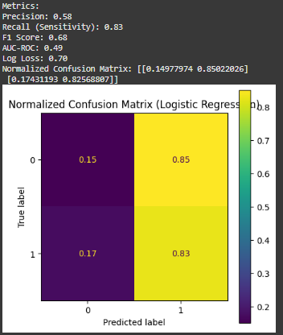
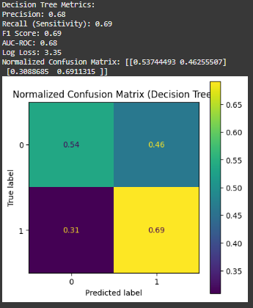
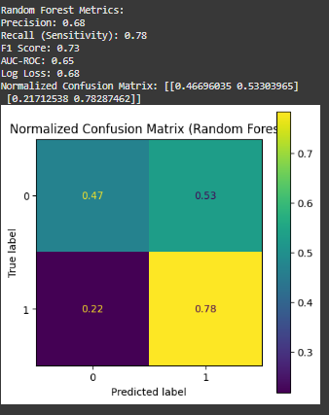
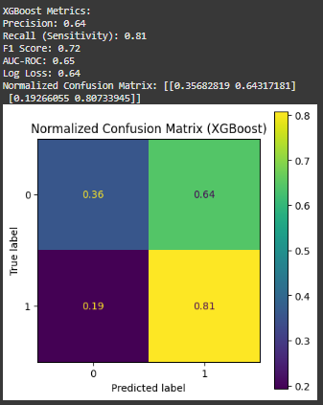
3-man Playmaking Stats
Model | Precision | Recall | F1-Score | AUC-ROC
Logistic Regression | 0.58 | 0.83 | 0.68 | 0.49
Decision Trees | 0.68 | 0.69 | 0.69 | 0.68
Random Forest | 0.68 | 0.78 | 0.73 | 0.65
XGBoost | 0.64 | 0.81 | 0.72 | 0.65

Slide 42
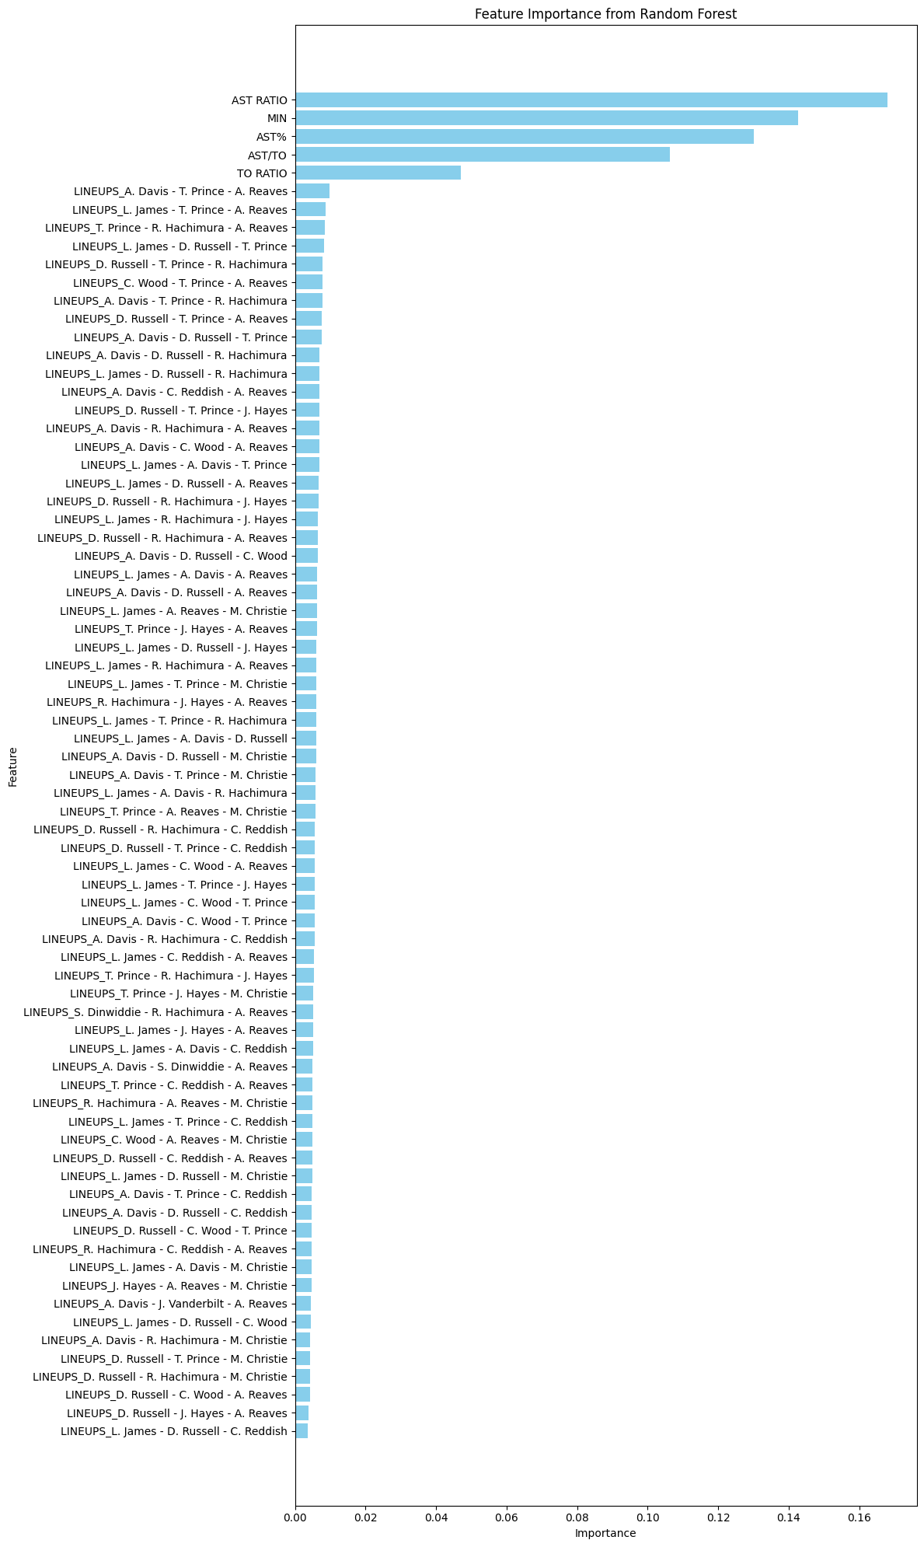
3-man All Stats Random Forest

Slide 43
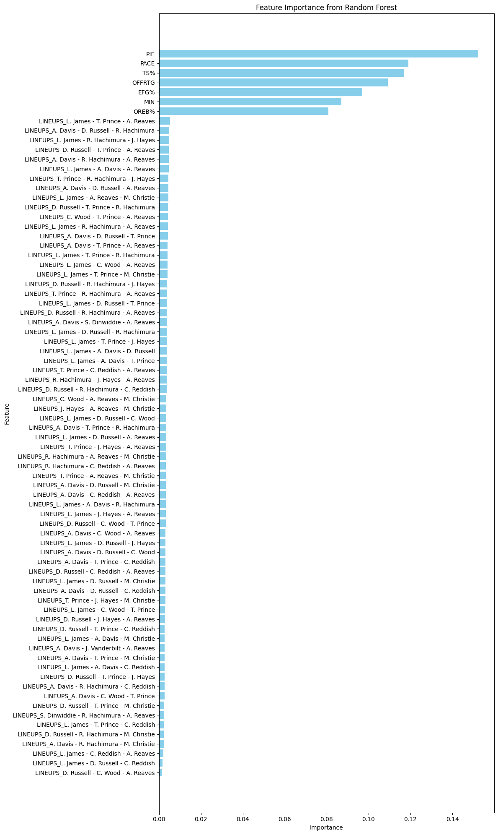
3-man Offensive Stats Random Forest

Slide 44
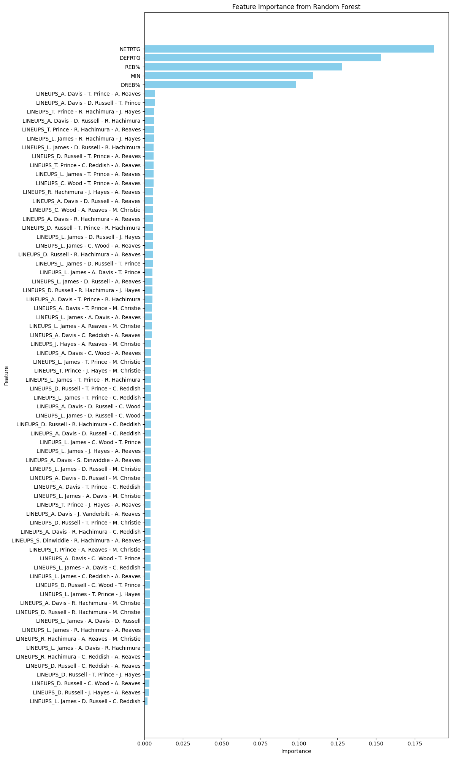
3-man Defesnive Stats Random Forest

Slide 45
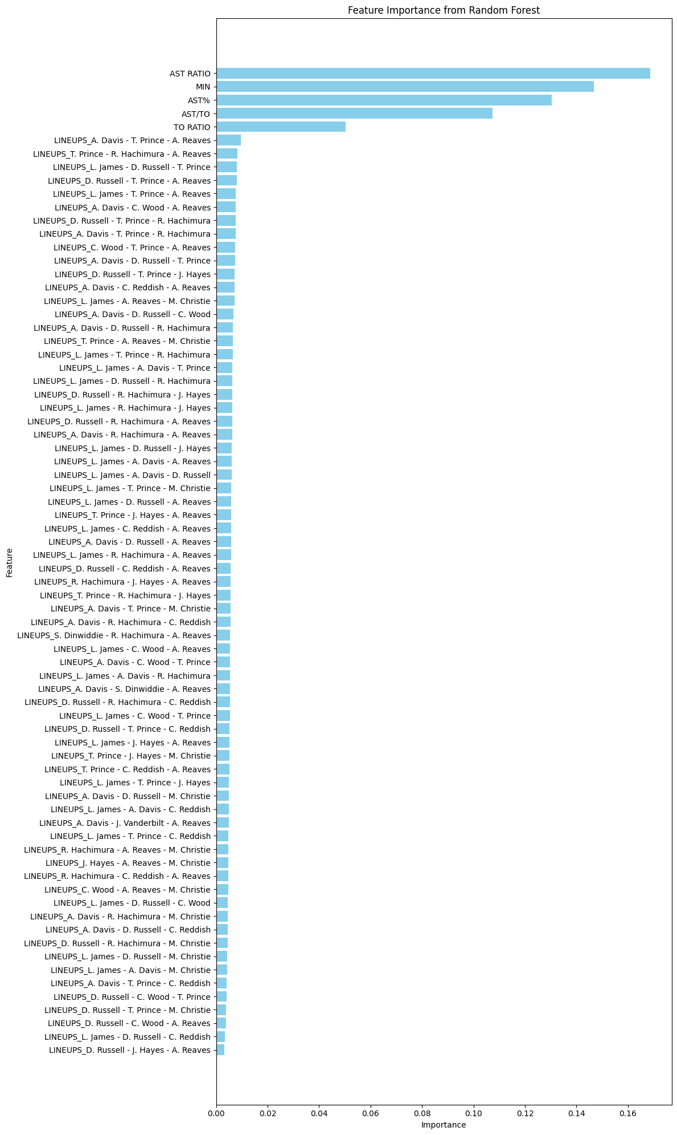
3-man Offensive Stats Random Forest

